Slide 1
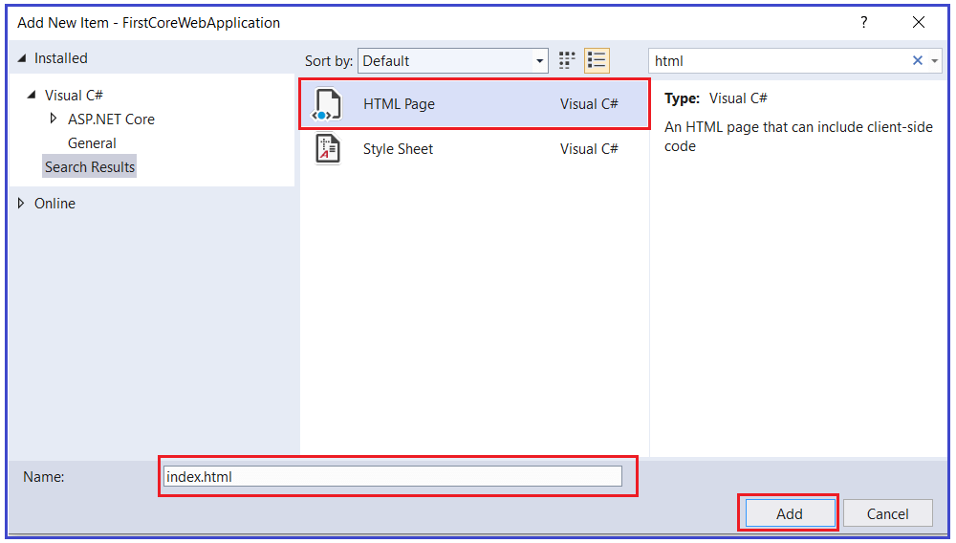
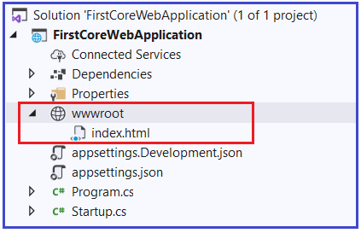
How to Configure Default Page in ASP.NET Core:
Adding one HTML Page:
Let us add one HTMP page with the name index within the wwwroot folder. To do so, right-click on the wwwroot folder and then select add => new item which will open add new item window. From the new item window, select the HTML template, provide the name as “index.html” and then click on the Add button as shown in the below image.
Once you add the HTML Page within the wwwroot folder, your project folder structure should be shown like below.

Slide 2
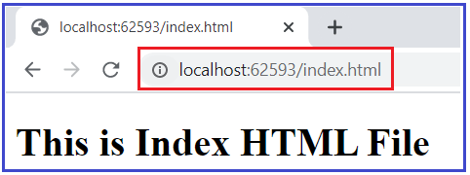
Now, open the index.html file which is present inside the wwwroot folder and then copy and paste the following code in it.
<html>
<head>
<meta charset="utf-8" />
<title></title>
</head>
<body>
<h1> This is Index HTML File</h1>
</body>
</html>
Modifying the Configure Method of the Startup class:
In order to server the static files in asp.net core applications, we need to use the UseStaticFiles middleware in the request processing pipeline. Let us modify the Configure method as shown below to use the UseStaticFiles middleware.
//Adding Static Files Middleware to serve the static files
app.UseStaticFiles();
app.Run(async (context) =>{
await context.Response.WriteAsync("Request handled and response generated");
});
} }
Now run the application and navigate to the URL: http://localhost:<portnumber>/index.html and you will see the output as expected that is coming from the static Index.HTML file as shown below.

Slide 3
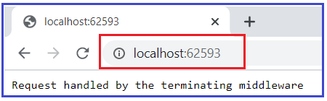
Now, if you remove index.html from the URL or navigate to the base URL, then the request is going to be handled by the terminating middleware which is registered using the Run method. That the default request is going to be server by the Run method as shown below.
But what we want is, when we navigate to the base URL as shown above, we want our index.html page to serve the request. That is, we need to set the index.html page as our default page.
Setting the Default Page in ASP.NET Core Application:
Most of the web applications have a default page such as index.htm(l) or default.htm(l) as their startup page as it is easy to remember. This is the web page that is going to be displayed when a user visits the root URL of that application. For example, if you have a page with the name index.html and you want that page to be your default page so that whenever any user visits your root URL, then that page is going to be displayed.
In order to serve the index.html page which is present inside the wwwroot folder as the default page of your application, you need to add another middleware i.e. UseDefaultFiles() middleware into the request processing pipeline.
So, modify the Configure() method of the Startup class as shown below to use the UseDefaultFiles() middleware which will set the default page for your application.

Slide 4
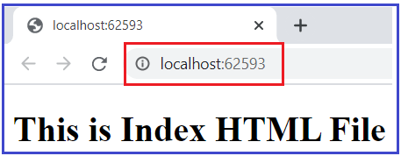
//Setting the Default Files
app.UseDefaultFiles();
//Adding Static Files Middleware to serve the static files
app.UseStaticFiles();
app.Run(async (context) =>{
await context.Response.WriteAsync("Request handled by the terminating middleware");
});
}
}
With the above changes in place, now run the application and you should the output as expected as shown below. That index.html page serves as your default page.
Note: You need to add the UseDefaultFiles() middleware before the UseStaticFiles() middleware in order to serve the default file.
The point that you need to remember is the UseDefaultFiles() middleware is just a URL rewriter and it never serves the static files.
The job of this middleware is to simply rewrite the incoming URL to the default file which will then be served by the Static Files Middleware.

Slide 5
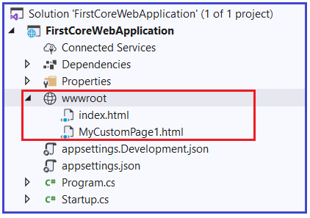
How to set Custom HTML Page as the Default Page?
The UseDefaultFiles() middleware will search the wwwroot folder for the following files.
index.htm
index.html
default.htm
default.html
This is the default behavior. But if you want then you can also change this default behavior. For Example, let us add another HTML page into the project wwwroot folder with the name MyCustomPage1.html. Once you add the MyCustomPage1.html file then the wwwroot folder contains two HTML files as shown in the below image.
<!DOCTYPE html>
<html>
<head><meta charset="utf-8" />
<title></title>
</head>
<body>
<h1> This is MyCustomPage1 HTML File</h1>
</body></html>
Now, open the MyCustomPage1.html file and then copy and paste the following code in it.

Slide 6
Setting MyCustomPage1.html as Default Page:
Now, we want the MyCustomPage1.html page to be our default page instead of the index.html page.
To do, you need to modify the Configure() method of the Startup class as follows.
Here, we are creating an instance of DefaultFilesOptions class and adding the default file name as MyCustomPage1.html and then passing this object to the UseDefaultFiles middleware.
//Specify the MyCustomPage1.html as the default page
DefaultFilesOptions defaultFilesOptions = new DefaultFilesOptions();
defaultFilesOptions.DefaultFileNames.Clear();
defaultFilesOptions.DefaultFileNames.Add("MyCustomPage1.html");
//Setting the Default Files
app.UseDefaultFiles(defaultFilesOptions);
//Adding Static Files Middleware to serve the static files
app.UseStaticFiles();
app.Run(async (context) =>{
await context.Response.WriteAsync("Request handled by the terminating middleware");
});
}
}

Slide 7
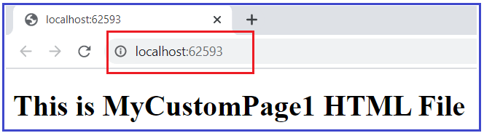
Now run the application and you will see the output as expected that is coming from the MyCustomPage1.html file as shown below. If you still see the output from the index.html page then it may be due to cache so just try to reload the page. If still, you are not getting the data from the MyCustomPage1.html file then just restart the visual studio.
What is the use of the UseFileServer() Middleware component?
The UseFileServer() middleware components combines the functionality of UseStaticFiles, UseDefaultFiles and UseDirectoryBrowser middleware.
We already discussed the UseStaticFiles and UseDefaultFiles middleware.
The DirectoryBrowser middleware as the name says enables the directory browsing which allows the users to see the files which are stored in a specific directory.
In our example, we can replace the UseStaticFiles() and UseDefaultFiles() middlewares with the UseFileServer() Middleware as shown below.

Slide 8
// Use UseFileServer instead of UseDefaultFiles & UseStaticFiles
FileServerOptions fileServerOptions = new FileServerOptions();
fileServerOptions.DefaultFilesOptions.DefaultFileNames.Clear();
fileServerOptions.DefaultFilesOptions.DefaultFileNames.Add("MyCustomPage1.html");
app.UseFileServer(fileServerOptions);
app.Run(async (context) =>{
await context.Response.WriteAsync("Request handled by the terminating middleware");
});
}
}
Now run the application and you will see the output as expected.

Slide 9
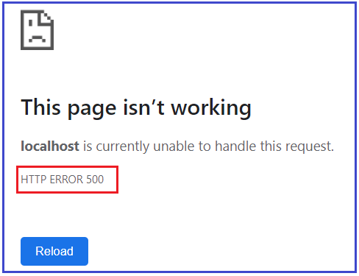
What is Developer Exception Page Middleware?
How to use Developer Exception Page Middleware in ASP.NET Core Application?
How to Customize the UseDeveloperExceptionPage Middleware in ASP.NET Core?
Where do we need to configure the UseDeveloperExceptionPage Middleware?
By default, ASP.NET Core application simply returns a status code for an exception that is not handled by the application. Let us understand this with an example. Please modify the Configure() method of the startup class as shown below where we throw an exceptio
When you run the application, you will get the following output.
app.UseRouting();
app.UseEndpoints(endpoints =>
{
endpoints.MapGet("/", async context =>
{
throw new Exception("Error Occurred while processing your request");
await context.Response.WriteAsync("Hello World!"); });
});
}
As you can see in the above image it gives you the status code as 500 which means Internal Server Error. But as a developer when you are developing the application, you should know the detailed information about the exception on the page so that you can take necessary actions to fix the error. And this where DeveloperExceptionPage Middleware comes into the picture.

Slide 10
How to use DeveloperExceptionPage Middleware in ASP.NET Core Application?
If you want your application to display a page that shows the detailed information about the unhandled exception, then you need to configure the Developer Exception Page middleware in the request processing pipeline. To do so, modify the Configure() method of the Startup class as shown below to add the Developer Exception Page middleware which will handle the unhandled exception that occurred in your application.
if (env.IsDevelopment())
{
app.UseDeveloperExceptionPage();
}
app.UseRouting();
app.UseEndpoints(endpoints =>
{
endpoints.MapGet("/", async context =>{
throw new Exception("Error Occurred while processing your request");
await context.Response.WriteAsync("Hello World!"); });
})
With the above change in place, now run the application and it should display the following page with the detailed information about the unhandled exception.

Slide 11
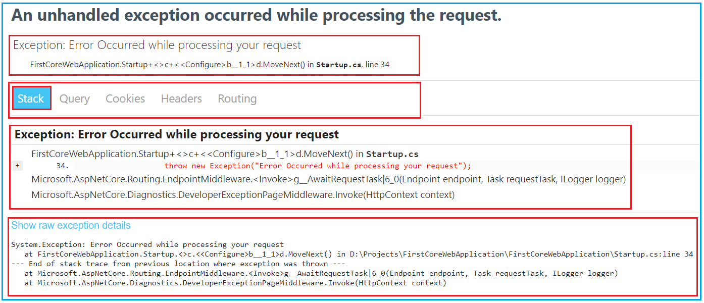
As you can see in the above image, the Developer Exception Page contains five tabs such as Stack, Queue, Cookies, Headers, and Routing.
Stack: The Stack tab gives the information of stack trace which indicated where exactly the exception occurred, the file name, and the line number that causes the exception.
Query: The Query tab gives information about the query strings.
Cookies: The Cookies tab displays the information about the cookies set by the request.
Header: The Header tab gives information about the headers which is sent by the client when makes the request.
Route: The Route tab gives information about the Route Pattern and Route HTTP Verb type of the method, etc.
Now if you verify the Query tab and Cookies tab, then you will not see any information as you are not passing any query string value in the URL or you are not setting the cookies in the request. In our upcoming articles, we will discuss the Query string and Cookies in detail.
Note: Please Enable the Developer Exception Page Middleware only when the application is running in the Development environment. You don’t want to share detailed exception information when the application is running in the production environment.

Slide 12
How to Customize the UseDeveloperExceptionPage Middleware in ASP.NET Core?
If you want then you can also customize the UseDeveloperExceptionPage middleware. The point that you need to remember is whenever you want to customize a middleware component in ASP.NET Core then you need to use the respective Options object. For example
UseDeveloperExceptionPage => to customize this middleware use DeveloperExceptionPageOptions object
UseDefaultFiles => to customize this middleware use DefaultFilesOptions object
UseStaticFiles => to customize this middleware use StaticFileOptions object
UseFileServer => to customize this middleware use FileServerOptions object
As we are going to customize the UseDeveloperExceptionPage() middleware component, so we need to use the DeveloperExceptionPageOptions object. So, modify Startup class as shown below.

Slide 13
if (env.IsDevelopment())
{
DeveloperExceptionPageOptions developerExceptionPageOptions = new DeveloperExceptionPageOptions
{
SourceCodeLineCount = 5
};
app.UseDeveloperExceptionPage(developerExceptionPageOptions);
}
app.UseRouting();
app.UseEndpoints(endpoints =>
{
endpoints.MapGet("/", async context =>
{
throw new Exception("Error Occurred while processing your request");
await context.Response.WriteAsync("Hello World!");
});
});
}

Slide 14
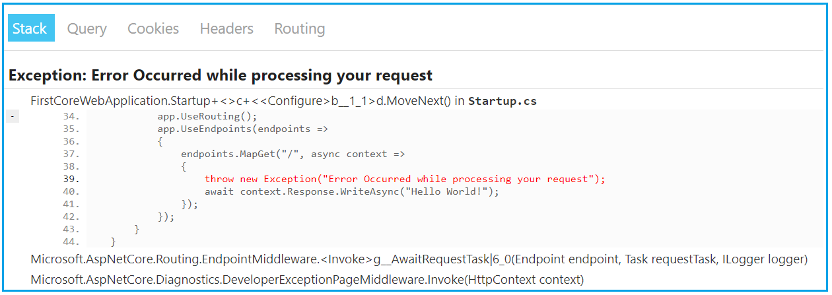

Slide 15
Where do we need to configure the UseDeveloperExceptionPage Middleware?
We need to configure the UseDeveloperExceptionPage() Middleware as early as possible in the application’s request processing pipeline so that it can handle the unhandled exception and then display the Developer Exception Page with the detailed information about the exception.
Let us see what happened when we configure the UseDeveloperExceptionPage() middleware after the middleware which is causing the exception. Please modify the Configure() method as shown below.
app.UseRouting();
app.UseEndpoints(endpoints => {
endpoints.MapGet("/", async context => {
throw new Exception("Error Occurred while processing your request");
await context.Response.WriteAsync("Hello World!"); });
});
if (env.IsDevelopment()) {
DeveloperExceptionPageOptions developerExceptionPageOptions = new DeveloperExceptionPageOptions
{ SourceCodeLineCount = 5 };
app.UseDeveloperExceptionPage(developerExceptionPageOptions);
}}
With the above changes in place, when we run the application, it will not display the developer’s exception page instead of simply returns the default error status code. This is the reason why we need to configure the UseDeveloperExceptionPage() middleware as early as possible to handle the unhandled exception of the application in the request

